Slide 1

Overview of UNDAF process and new guidance package
unite and deliver effective support for countries
May 2010
Notes:
Main themes from recent UN reform discussions. The presentation will focus on the last point – UNDAF development and the new UNDAF Guidance Package.
TCPR directives on system-wide coherence
2 tracks to advance reform: DaO & UNDAF roll outs
Management and Accountability Framework
Enhanced regional UNDG teams support
Strengthened RC/UNCT performance appraisals and improved UNDG Toolkit
UNDAF development and the new UNDAF Guidance Package
Context: In the regional workshops, this presentation will fall (in the first session of the first day) after a presentation on the status of UN Reform discussions, and before subsequent in-depth sessions presentations on different aspects of this presentation. In this sense, this presentation provides an overview of everything that will be discussed in the workshop. The presenter should therefore aim to make the transition from UN Reform to UNDAF.

Slide 2

Picking up from UN Reform
Notes:
Main themes from recent UN reform discussions. The presentation will focus on the last point – UNDAF development and the new UNDAF Guidance Package.
TCPR directives on system-wide coherence
2 tracks to advance reform: DaO & UNDAF roll outs
Management and Accountability Framework
Enhanced regional UNDG teams support
Strengthened RC/UNCT performance appraisals and improved UNDG Toolkit
UNDAF development and the new UNDAF Guidance Package
Context: In the regional workshops, this presentation will fall (in the first session of the first day) after a presentation on the status of UN Reform discussions, and before subsequent in-depth sessions presentations on different aspects of this presentation. In this sense, this presentation provides an overview of everything that will be discussed in the workshop. The presenter should therefore aim to make the transition from UN Reform to UNDAF.

Slide 3

Why new UNDAF Guidance?
Demand from UNCTs to simplify UNDAF process
TCPR and ECOSOC requirements
Lessons learned from Delivering as One pilots and other countries
Notes:
UNDAFs often lack focus and strategic prioritization
Process to prepare an UNDAF is a lengthy and inflexible
Comparative advantage of the UN in-country is vague
UNDG Chair: in her letter to RC/UNCTs October 2009, stressed that the UNDAF is the key expression of what the UN stands for at the country level. And she encouraged a step change in relevance and quality of the UNDAFs.
Focus: The pressure remains to have all ongoing and already planned activities in the UNDAF rather than focusing on a limited set of national priorities and realistically assessing the UN development system’s comparative advantages at the country level.
Context of challenges: competing demands; lack of consistent messages and leadership from UN system regional and HQ level; tendency to include all ongoing activities; poor consultative process that leads to weak national ownership
The UNDAF should focus on the UN’s contribution to addressing national priorities – it should not be driven by agency mandates or UN areas of expertise that do not contribute to addressing national priorities. The UNDAF should not include everything the UN system could potentially contribute but what it will contribute to addressing national priorities based on its comparative advantages
Inflexible: Previous UNDAF guidelines have prescribed a specific course of action to follow when preparing the UNDAF that lasted for some 18 months. UNCTs have identified this process as lengthy and burdensome, diverting their attention from operationalizing their ongoing programmes. The aim of the current guidance package is to offer UNCTs flexibility in designing the length of UNDAF timeline while improving its strategic focus.
Comparative advantages: UNDAFs are increasingly aligned to national goals but often lack focus – in addition, there continues to be a lack of strategic positioning and clear division of labour among agencies.
So while responding to national priorities and advocating for international norms and standards, the UNCT is required to assess its capacities and focus its efforts where it can best provide leadership and make the biggest difference, avoid duplication and establish synergies with ongoing interventions.
The UNDAF guidance package offers a method for UNCTs to use when assessing its strengths and weakness – called a SWOT analysis. To ensure flexibility, the UNCT may use this method or choose another it deems appropriate.

Slide 4

Feedback Overview
Feedback Overview
UNDAFs often lack focus and strategic prioritization
Process to prepare an UNDAF is a lengthy and inflexible
Comparative advantage of the UN in-country is vague
Notes:
UNDG Chair: in her letter to RC/UNCTs October 2009, stressed that the UNDAF is the key expression of what the UN stands for at the country level. And she encouraged a step change in relevance and quality of the UNDAFs.
Focus: The pressure remains to have all ongoing and already planned activities in the UNDAF rather than focusing on a limited set of national priorities and realistically assessing the UN development system’s comparative advantages at the country level.
Context of challenges: competing demands; lack of consistent messages and leadership from UN system regional and HQ level; tendency to include all ongoing activities; poor consultative process that leads to weak national ownership
The UNDAF should focus on the UN’s contribution to addressing national priorities – it should not be driven by agency mandates or UN areas of expertise that do not contribute to addressing national priorities. The UNDAF should not include everything the UN system could potentially contribute but what it will contribute to addressing national priorities based on its comparative advantages
Inflexible: Previous UNDAF guidelines have prescribed a specific course of action to follow when preparing the UNDAF that lasted for some 18 months. UNCTs have identified this process as lengthy and burdensome, diverting their attention from operationalizing their ongoing programmes. The aim of the current guidance package is to offer UNCTs flexibility in designing the length of UNDAF timeline while improving its strategic focus.
Comparative advantages: UNDAFs are increasingly aligned to national goals but often lack focus – in addition, there continues to be a lack of strategic positioning and clear division of labour among agencies.
So while responding to national priorities and advocating for international norms and standards, the UNCT is required to assess its capacities and focus its efforts where it can best provide leadership and make the biggest difference, avoid duplication and establish synergies with ongoing interventions.
The UNDAF guidance package offers a method for UNCTs to use when assessing its strengths and weakness – called a SWOT analysis. To ensure flexibility, the UNCT may use this method or choose another it deems appropriate.

Slide 5

What is expected of the Simplified
UNDAF Guidelines?
  Empower UNCTs to engage in programming processes in a flexible way that responds to local realities
  Closely align the UNDAF with national planning, as required by the TCPR 2007
  Additional mechanisms for accountability and transparency among agencies
  Greater coherence at the operational level
  Lighter process is a timely input for the
  46 UNDAF roll-out countries in 2010
Notes:
Simplified Guidelines will help UNCTs to adapt to country contexts and realities: “no one size fits all” (MICs, LDCs, post-conflict, etc.)
NB: A more flexible UNDAF programming process (with options at different steps) will allow UNCTs to more easily align to national priorities (as required by TCPR). This guidance comes at the appropriate time with the UNDAF roll-out of 46 countries in 2010.

Slide 6

Any questions until now?

Slide 7



The three parts of the 2010
UNDAF Guidance Package
UNDAF Progress
Reporting
UNDAF Action Plan Guidance
UNDAF Guidelines
& Technical Guidance
Notes:
The UNDAF guidance package consists of three main parts: (1) UNDAF Guidelines and Technical Guidance (Parts I and II); (2) the UNDAF Action Plan, which includes two technical annexes; and (3) the UNDAF Progress Report (also known as the ‘Standard Operational Format’)
The new UNDAF guidelines package offers greater flexibility in how the UNCT chooses to conduct its UNDAF exercise – in response to feedback from UNCTs that the UNDAF process was too rigid and lengthy. Part (I) of the new guidance package sets out the basic steps that all UNCTs should follow in developing their UNDAF while at each stage of the process offering different options to follow. In this way, the new guidance package is more flexible and less prescriptive. Part II of the Guidance Note (‘Technical Guidance’ in this slide) contains in-depth guidance on how to approach each of the main steps outline in Part I.

Slide 8

Elements of Strategic Focus
National Ownership
Alignment with national development priorities
Inclusiveness of UN system, including NRAs
Integration of the five programming principles
Mutual accountability for development results
Notes:
Touch on these main points as central to the development of an UNDAF in line with TCPR directives. The presentation will highlight (1) the programming principles and (2) mutual accountability.
National Ownership: Ownership of the entire UNDAF process. Leadership at each stage of the process. UN’s advocacy role in fostering national ownership of the UN normative agenda.
Alignment: With national priorities and the national planning cycle. the UNDAF, and the country analysis from which it emerges, needs to be based on and aligned with national development priorities and strategies. This requires government leadership and engagement of all relevant stakeholders, in all stages of the process, to maximize the contribution that the UN system can make, through the UNDAF, to the country development process.
Inclusiveness: UNCTs should seek inclusiveness of the UN system with full involvement of specialized and non-resident agencies.
Integration of five programming principles (human rights-based approach, gender equality, environmental sustainability, results-based management, and capacity development) tailored to the country context. Slide 9 deals specifically with this.
Mutual accountability: Mutual accountability has become established as a consideration of development and aid effectiveness, although questions remain on its actual implications. For the purpose of the UNDAF, mutual accountability is interpreted to mean the respective accountability of parties working together towards shared outcomes. This notion of respective accountability reflects the fact that accountability is not fungible and must, in the final analysis, be attached to a specific actor. Many stakeholders contribute to UNDAF outcomes and each is accountable for its contribution. The UNDAF Progress Report will focus on UNCT contributions to these outcomes and, as such, will address the respective accountability — at the outcome level — of each UNCT. Following this reasoning, mutual accountability is closely embodied in RBM principles and a central feature of the new guidance on UNDAF progress reporting (Standard Operational Format).
A note on advocacy: The UNCT is required, both to support national priorities and to advocate for the inclusion of governments’ international/global commitments to the MD/MDGs and internationally agreed development goals, and their obligations under international human rights, international norms and standards, and other instruments, into national priorities.

Slide 9

Programming principles & thematic guidance notes for country analysis and UNDAF
The fab five:
HRBM
Gender equality
Environmental sustainability
Results-based Management
Capacity development
Notes:
UNCT are required to apply the five programming principles which are intended to strengthen the quality and focus of UN responses to national priorities based on UN’s common values and standards. Together, these programming principles constitute a starting point and guide for the country analysis, as well as for all stages of the UNDAF formulation, including results planning, implementation, monitoring and evaluation. For details on the five programming principles and other key cross-cutting issues, refer to Chapter II of Technical Guidance and the recently issued Guidance Note: Application of the Programming Principles to the UNDAF.
Agreement about the 5 programming principles emerged from inter-agency discussions in 2006 to revise the UNDAF Guidelines. It is widely agreed that all 5 are necessary for effective UN-supported country programming that must balance the pursuit of international norms and standards with the achievement of national development priorities. A principle gives a basis for reasoning and action These contained 11 guiding principles, seen as too cumbersome for use with stakeholders. Revised guidelines identify 3 key elements for country level performance, 5 inter-related principles that apply to UN supported programming at all time and in all stages of the UNDAF process, and a group of cross-cutting thematic issues to best respond to country priorities.
This process is within the framework of system wide coherence described in the UNDAF guidelines, parts 1-3.
Also note that there are other key cross-cutting thematic issues for UNCT considering when developing an UNDAF. These are applied based on the country context.
Conflict analysis
Disaster risk reduction
Climate change
HIV/AIDs
Food crisis and hunger
Indigenous peoples
Trade and productive capacity
Employment and decent work

Slide 10

Clarity of Roles and Responsibilities for an UNDAF
Resident Coordinator
UN Country Team
Regional UNDG Teams and their peer support groups
Notes:
The UNDG has endorsed the Management and Accountability System for the UN Development and RC System, which provides an overview of the agreed responsibilities and accountabilities, including in the context of UNDAF.

Slide 11

Mandatory Steps
UNDAF Guidelines
1. Road Map
2. Country Analysis
3. Strategic planning
(Results Matrix)
4. M&E
Notes:
There are 4 main steps in the process of developing an UNDAF. These are (1) Roadmap (2) Country Analysis (3) Strategic Planning (4) Monitoring & Evaluation. While these steps are mandatory, UNCTs may undertake each step in a flexible manner in response to the national context and with a view to meeting the minimum requirements.
Roadmap must be developed for preparation of UNDAF
Country analysis must inform strategic planning of UNDAF
Strategic Planning: a results matrix for every UNDAF is a must
M&E: M&E plan, annual review process, evaluation required
Mandatory vs. Flexibility. UNCTs have emphasized the need for flexibility in UNDAF programming processes. The new guidance states that these four steps are mandatory as well as mainstreaming the 5 programming principles. It is importance to strike a balance between what is mandatory and why the new guidance is more flexible. It is key to stress that while the steps are mandatory the UNCT has the flexibility in how it chooses to implement them.
NB: UNCT should not understand ‘flexibility’ to mean ‘it is not necessary’.

Slide 12
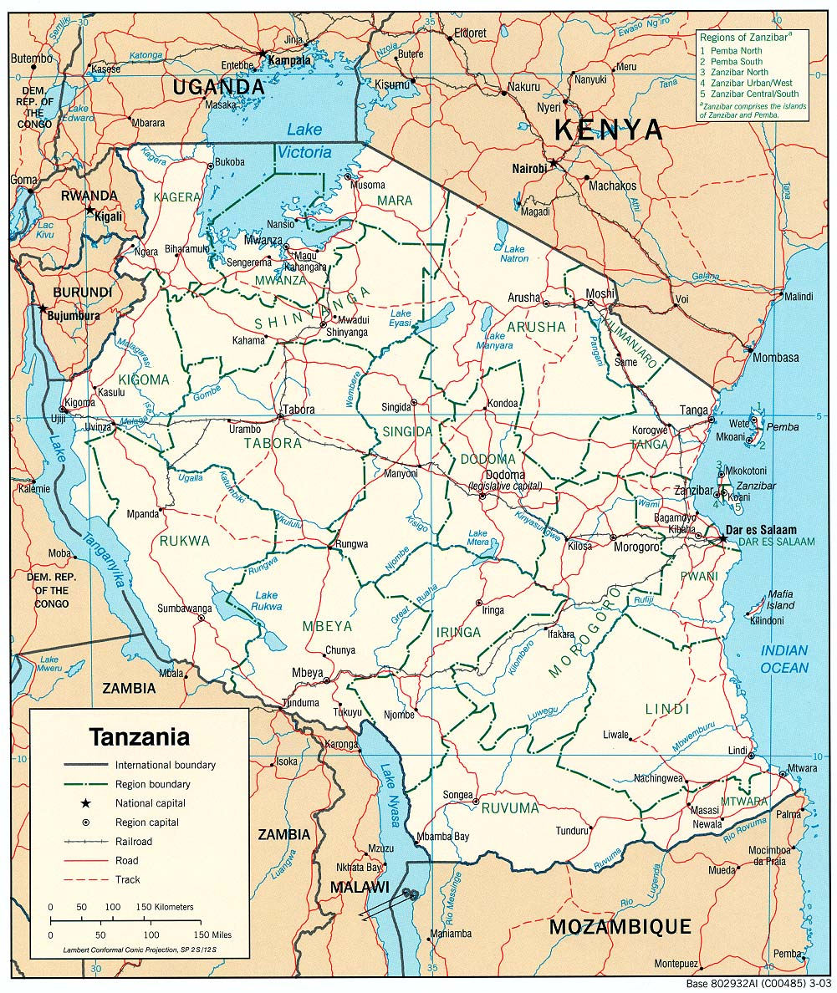
Road Map
Road Map
  Purpose: Organize the UNDAF Process
  Outline the UNDAF preparation process
  Identify support needed from regional offices and HQs
  Ensure a full consultative process throughout to ensure national ownership
  Ensure full alignment to national planning cycle
Notes:
Set out a plan that includes all steps of the process: country analysis; strategic planning; M&E.
Role of partners and first look at costs
Ensure a consultative and inclusive process
Ensure alignment with national planning cycle
Timeline: Potentially significant reduction in the current timeline of 24 months. ExCOM agencies are recommended to urgently address the issue of reducing the timeline of country programme document approval process, with their respective Executive Boards. This will ensure that the agency-specific programming cycle is harmonized with the UNDAF cycle, and thereby, the national planning cycle.
NB: Currently the only inflexible aspect of the UNDAF timeline is the required agency submission of their country programme documents to their respective governing bodies. This is generally required by March of the last year of the programming cycle. UNCTs need to take this into consideration when laying out their road maps.
Flexible mechanisms:UNCTs are given flexibility to identify appropriate coordination mechanisms and consultative processes, with all stakeholders for drafting, reviewing and validating the UNDAF.

Slide 13
Road Map
What’s new and important about the Road Map?
  No prescribed calendar for the process (to closely align UNDAF with the national processes and calendar)
  No prescribed mechanisms for engagement with partners
  (example, no JSM)
  More flexibility
Remember: Do not underestimate the time needed for the common programming process.
Notes:
For the sake of flexibility, as indicated in TCPR and UNCT feedback, the 24 month timeline that used to appear in the 2009 guidelines have been removed. The only ‘timelines’ per se that UNCT must consider are (1) national planning timeline/processes and (2) agency specific requirements for submission and approval of their respective country programmes to their governing bodies.
Emphasize that despite the flexibility, UNCT should not underestimate the time and dedication needed to conduct the UNDAF process. NB: allow ample time to get things done.

Slide 14
Group Work
What are the 3 main issues you are facing in developing your UNDAF?

Slide 15

A Country Analysis will:
Strengthen country analytical capacities to develop high-quality development objectives
Notes:
In order to ensure ownership, leadership and full participation of national authorities in all phases of the programming process, the UNCT determines whether a common country assessment is necessary or whether it can select any other option. The purpose of the UNCT’s analytical contribution is to strengthen country analytical capacities, processes and products, and thereby contribute to the articulation of high quality development objectives and priorities within the UNDAF and the national development plan. Good analysis includes identification of areas where the country has not been able to reach internationally agreed development goals and commitments to international norms and standards, and how to assist the country to do so. A clear comparative advantage that the UNCT can bring to a country’s analytic work is to help identify priority development problems.

Slide 16
Country Analysis
Review of existing analytical process & products to determine they meet minimum quality standards
2. Conduct country analysis:
  (a) Participation in Gov-led analytical work
  (b) Complementary UN-supported analytical work focusing on gaps in existing analysis
  (c) A full Common Country Assessment
3. Map UNCT work in country and determine UNCT comparative advantages
Notes:
These are the basic steps to consider when deciding how to conduct a country analysis. The focus is again on flexibility within this mandatory step 1. The UNCT and partners may choose any of the three or other options: (i) UNCT participation in government-led analytical work and use of government analysis, including sectoral reviews and analyses (ii) Complementary UN-supported analytical work, with a focus on gaps in the existing analysis (iii) A full Common Country Assessment (CCA). (For details of guidance on 3 options for country analysis; structure and content of CCA document, refer to Chapter III of Technical Guidance). Recognizing that analysis is an important contribution that the UN system can and does make on an ongoing basis, throughout a programming or development cycle, UNCTs have an additional option of summarizing the relevant findings from the recent years of data collection and analytical processes, with the most up-to-date data available, for use by the UNCT and partners.
Steps leading to a strategic UNDAF in the country analysis: (a) gather information; (b) asses information (define development problems for deeper analysis); (c) analysis (root causes and their links):
Causal analysis
Role – Pattern Analysis
Capacity gap analysis
UN comparative advantage
Strategic UNDAF
Note on comparative advantage.
In assessing its strengths, the UNCT includes an overview of all normative and operational work carried out by agencies at the country level, and expertise within the wider UN system that could become relevant in the particular – or emerging – country contexts. The UNCT must clearly articulate the strategic roles for UN cooperation based on the UN’s mandate and mission as applied to the country context. The UNCT specifically analyses its comparative advantages in the country, to contribute towards achievement of national development priorities. Comparative advantage is not interpreted to mean agency mandate; rather it is a realistic assessment of expertise and value added, and may draw on agency-specific assessments. A national consultative process is followed to identify the expectations of the government and civil society as well as the relative roles of the bilateral and multilateral partners.
New? Self-explanatory. One point -- the emphasis on ‘summarizing findings’ is to underline flexibility. However, UNCTs should keep in mind the importance of doing a strong country analysis.

Slide 17
Country Analysis
What’s new and important about the Country Analysis?
Flexibility to summarize findings from recent up-to-date data sources and analytical processes
Flexible timeline allows UNCTs to decide when to undertake the analysis
  Remember: Strong country analysis is more likely to lead to a strong UNDAF and ultimately strong agency programming.
Notes:
Self-explanatory. One point -- the emphasis on ‘summarizing findings’ is to underline flexibility. However, UNCTs should keep in mind the importance of doing a strong country analysis.
Remember: Strong country analysis is more likely to lead to a strong UNDAF and ultimately strong agency programming.

Slide 18

Strategic Planning will…
Develop results against national priorities and how you will achieve them
Notes:
The UNDAF reflects the comparative advantage of the UN by emphasizing the thematic competence of the agencies involved, without necessarily highlighting their specific mandates. It shows where the UN system can bring its unique strengths to bear in advocacy, capacity development, programming, and cutting edge knowledge and policy advice, for the achievement of the internationally agreed standards and development goals, including MD/MDG related national priorities

Slide 19
Strategic Planning
Conduct a Strategic Prioritization Exercise
Select priorities and outcomes (use as a guide 5 programming principles, MfDR principles & UN comparative advantages
Develop an UNDAF Results Matrix
Obtain feedback on Results Matrix (UNCT self-assessment, Gov feedback, PSG review)
Signing of the UNDAF w/ Government
Notes:
Lays out basic steps to follow when developing your UNDAF narrative and Results Matrix.
The aim is to relate the comparative advantages of the UN system to specific national development priorities, in a particular country, as well as the collective resources of the UN system, in relation to other resources available to the government, such as through national budget, private sector, international financial institutions and bilateral aid.
The country analysis and prioritization exercise is the basis for drafting the results matrix, and therefore, the UNDAF document, and for identifying potential joint programmes.

Slide 20
Strategic Planning
Strategic Planning
What’s new and important in Strategic Planning?
Only one outcome level in the UNDAF results matrix
Simplified results matrix that integrates the M&E framework
Option to keep UNDAF at strategic outcome level (there are two options for developing your UNDAF results matrix)
Notes:
Strategic Planning: The current results matrix was found too detailed and rigid, going into many pages. It became more of an operational tool rather than providing a strategic vision of the UNCT. This was a highly debated issue in the UNDG. The simplified guidelines leave the choice to UNCTs depending on the country context. Specific guidance is provided to help UNCTs in determine their choice. The UNCTs must ensure that the flow of the results chain is maintained.

Slide 21
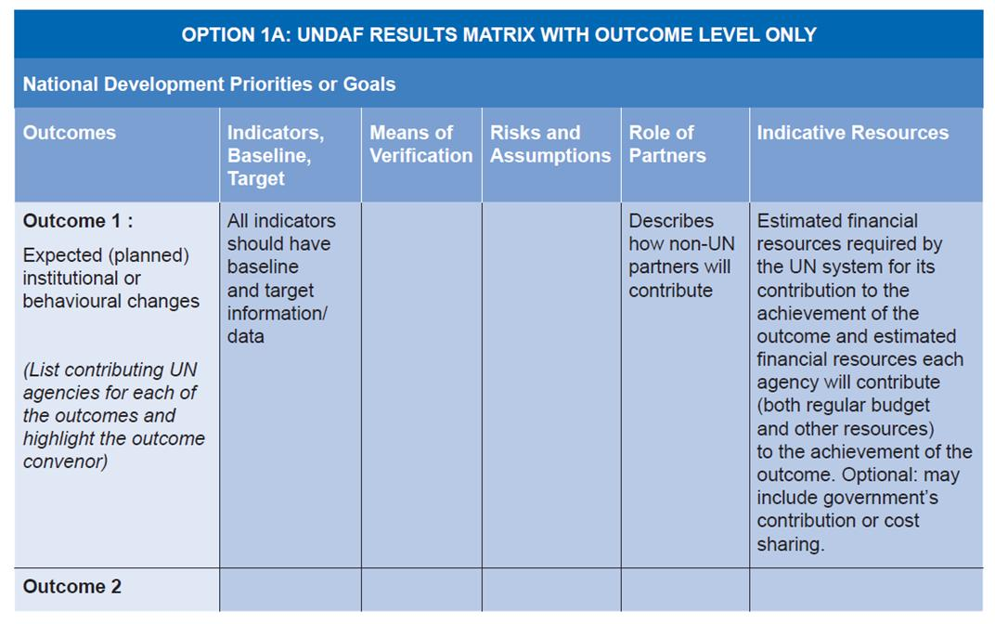
Results Matrix
Results Matrix
Notes:
Option 1A. This and the next slide describe visually the differences in the Results Matrix described in slide 20.

Slide 22
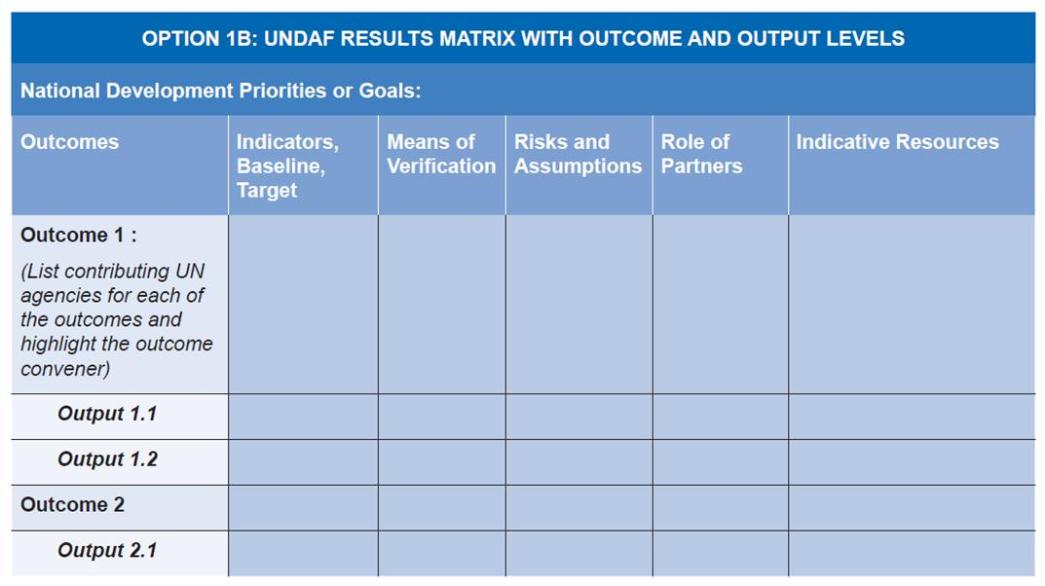
Results Matrix
Results Matrix
Notes:
Option 1 B. This and the last slide describe visually the differences in the Results Matrix described in slide 20.

Slide 23

Monitoring and Evaluation…
M&E
Tracks UNDAF Results
Notes:
UNDAF Monitoring and UNDAF Evaluation are linked but distinct processes. In line with the principles of Managing for Development Results, UNCTs ensure that they (i) capitalize on existing national M&E systems whenever possible and feasible, (ii) provide support to areas where further strengthening of national systems is required, while avoiding an excessive burden on partner countries with UNDAF-specific M&E requirements

Slide 24
M&E
Monitoring and Evaluation are distinct and required
Basic elements:
Develop the mandatory M&E Plan
Conduct the mandatory UNDAF annual review process with Government
Produce a single UNDAF progress report per cycle
Conduct evaluation of the UNDAF
Notes:
The difference between monitoring and evaluation
Monitoring tracks progress towards the results agreed in the matrix, and checks if the assumptions made and risks identified at the design stage are still valid or need to be reviewed. Thus it helps the UNCT and implementing partners to make mid-course corrections as an integral part of programme management.
Evaluation determines whether the results made a worthwhile contribution to national development priorities, and the coherence of UNCT support. While it makes an essential contribution to managing for results, it is an external function that is separated from programme management.
The M&E Plan highlights mechanisms or modalities for monitoring the achievement of outputs and the contribution towards achievement of outcomes.
The annual review process is where the UNCT primarily engages with government and other partners to review overall progress towards results, take stock of lessons and good practices that feed into the annual planning processes and commitments for the coming year.
As required by the TCPR, UNCTs produce an UNDAF progress report to national authorities on progress towards the outcomes of the UNDAF results matrix. The UNCT draws on available evidence of what the UN has contributed towards these outcomes. The UNDAF progress report does not discuss UN supported activities. It reports on how the outputs, produced by the UN or specific UN supported projects and programmes, contribute towards progress in achieving the outcomes of the UNDAF results matrix. The TCPR 2007 requests that “the resident coordinator, supported by the United Nations country team, should report to national authorities on progress made against results agreed in the United Nations Development Assistance Framework”.

Slide 25
M&E
What’s new and important about M&E?
Annual review is mandatory (must be documented)
One progress report per cycle (frequency determined by UNCT). Mid-term reviews not necessary.
Flexibility: Align annual review with national review. Link UNDAF evaluation with national evaluations; modalities flexible.
Notes:
As a minimum, a single UNDAF progress report must be produced per UNDAF cycle, with the timing to be agreed between the UNCT and national authorities.
Option of reporting frequency: UNCT, in consultation with government and other key partners, may produce more than a single UNDAF progress report per UNDAF cycle, if this adds value.
UN agencies and their partners remain accountable for performance of individual projects and programmes and the UNDAF progress report does not blur this line of accountability. Flexibility remains the hallmark – should PRSP and SWAP annual reviews tale place, the UNDAF annual review should align with them. Any decision by the UNCT to align closely with the national review, however, will have gauge the quality of that review and potential conflicting calendars.

Slide 26
Any questions until now?

Slide 27
What’s New in the
UNDAF Guidance Package?
UNDAF Progress
Reporting
UNDAF Action Plan Guidance
UNDAF Guidelines
& Technical Guidance
Notes:
The UNDAF guidance package consists of three main parts: (1) UNDAF Guidelines and Technical Guidance (Parts I and II); (2) the UNDAF Action Plan, which includes two technical annexes; and (3) the UNDAF Progress Report (also known as the ‘Standard Operational Format’)
The new UNDAF guidelines package offers greater flexibility in how the UNCT chooses to conduct its UNDAF exercise – in response to feedback from UNCTs that the UNDAF process was too rigid and lengthy. Part (I) of the new guidance package sets out the basic steps that all UNCTs should follow in developing their UNDAF while at each stage of the process offering different options to follow. In this way, the new guidance package is more flexible and less prescriptive.

Slide 28

UNDAF Action Plan
Key Features:
  Complements UNDAF with a common operational plan
  Specifies strategies used
  to deliver UNDAF results
  Replaces Country Programme Action Plans
  It’s voluntary
Notes:
The action plan consolidates the experiences from the Delivering as One pilot countries and other UNCTs that are striving for greater coherence.
Experience: Several UNCTs around the world experienced the need of a common programming document to ensure that the strategic priorities identified in the UNDAF are operationalized in a coherent way through agencies’ programmes. Rwanda called this a Common Operational Document, Viet Nam called it One Plan and Albania called it One Programme. The level of detail in these documents differs, but the common feature was a desire to jointly plan for the implementation of the UNDAF, to make it operational. Several other countries simultaneously came up with similar innovations, such as Papua New Guinea with its UN Country Programme Action Plan and Bhutan and Suriname with a “common CPAP” (including all participating agencies).
The Action Plan specifies the modalities of how the agencies (individually or jointly) are going to achieve the strategic results agreed to in the UNDAF framework. It specifies the outputs and strategies that agencies will use to achieve the results. UNCTs can consider agreeing on the generic terminology to use beforehand in order to have an even more coherent overview of what each is doing to implement the results. The level of specificity is chosen to be broad enough to allow planning for a five year cycle while being specific enough to indicate how the agency intends to achieve the result.
- It defines more in detail than the UNDAF what partners the UN agencies will work with.
- It also mentions the financial modalities (e.g. application of HACT) that will be used for the transfer of funds to partners. The advantage is that the Action Plan will provide a better overview of the activities and progress made on HACT with different partners
- It stipulates the M&E processes and mechanisms to be used in order to implement the UNDAF M&E plan
The document also ensures the legal agreements and commitments on the side of the UN and government to make the implementation of the agreed programme possible – this legal agreement is based on the generic, long-term legal agreement that establishes the presence of agencies in the country (e.g. the Standard Basic Assistance Agreement for UNDP or the Basic Cooperation Agreement with UNICEF – please note that not all agencies have such agreements in place, e.g. NRAs), but represents a more specific formal agreement that the UN can implement the programmatic activities planned for in the UNDAF within the agreed timeframe.
NB: Agency-specific activities that fall outside the UNDAF matrix should be detailed in the UNDAF narrative (section 3) and subsequently fleshed out in the agency annual work plans.

Slide 29
UNDAF Action Plan
  Implications:
  Lower transaction costs for
  national counterparts
  Less risk of fragmentation
  More coherence in UNDAF implementation
Notes:
The intended purpose of the UNDAF Action Plan (one operational document) is to lower transaction costs for government and other partners; lessen the chances of fragmentation and duplication among UN agencies; and thus ensure greater coherence in implementing the UNDAF.
Benefits of the Action Plan are many:
1. It provides a detailed overview of how the UN agencies will be working towards planned results, increasing transparency on what the UN is doing in the country
2. It will also simplify for the host government the documentation on the UN programme: only one common document instead of different agency documents. This is not to say there will be no further agency documents (e.g., annual work plans, joint programme documents, project documents, ExCom country programme documents remain valid) but these do not require the same type of agreement with the government.
3. The Action Plan will help to maintain a clear link between what the agencies are doing and the strategic results as agreed in the UNDAF. It prevents the fragmentation that sometimes happens after the UNDAF is agreed, where agency documents are not always congruent with the UNDAF and agencies sometimes go their own way without much reference to the UNDAF (“UNDAF put in the desk drawer and never looked at again”)
4. Perhaps most importantly, the UNDAF Action Plan will strongly enhance coherence of the UN interventions at country level, as it ensures that the UNDAF strategic framework is translated into practical agreements on how to implement it, and how to manage this implementation process together. It also helps to further reduce overlap and duplication.
5. Finally, it helps to establish clearer accountabilities by specifying the commitments of each agency contribution to achieving the results agreed. The Action Plan also includes more detail on the M&E processes and mechanisms to ensure implementation of the UNDAF M&E framework, and thereby helps to increase accountability as well.

Slide 30
UNDAF Action Plan
Contents of the UNDAF Action Plan
Signature page
Partnership, values and principles
Implementation strategies
Management and Accountability Arrangements
Resources and RMS
Communication
M&E
Commitments of the Government
Other provisions
UNDAF Action Plan Matrix

Slide 31
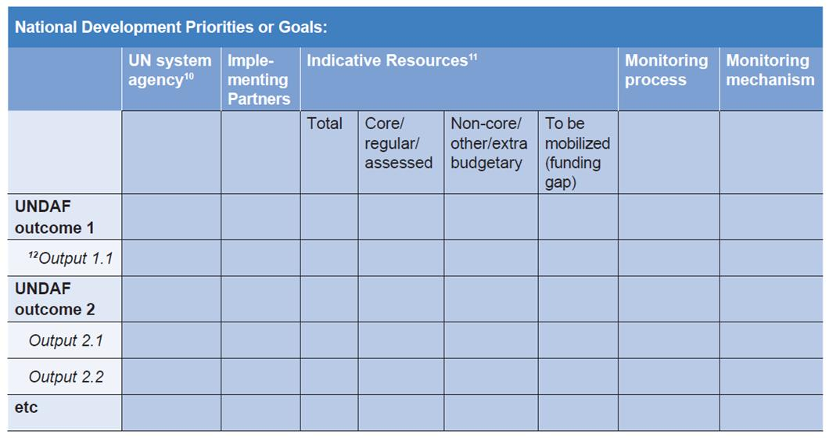
UNDAF Action Plan Matrix

Slide 32
Feedback Overview
A
Country Analysis -> UNDAF 1a -> CPDs -> CPAPs/Ag. Programmes -> AWPs
Feedback Overview
Implications:
picture of UN strategic intention, with no details
fosters UN strategic dialogue
But:
possible disconnect with UNDAF
less agencies’ engagement & ownership
governments’ transaction costs
B
Country Analysis -> UNDAF 1a -> CPDs -> UNDAF Action Plan-> AWPs
Implications:
replaces CPAPs/Ag programmes
brings together programming, budgets and oper-s
fosters mutual accountability
reduces transaction costs for gov’ts
But:
greater coordination efforts
agencies’ buy-in is critical
strengthened RCO capacity
programming process sequence
C
Country Analysis -> UNDAF 1b -> CPDs -> CPAPs/Ag. Programmes -> AWPs
Implications:
most familiar and “comfortable”
clear linkage between UNDAF & ag. programmes
But:
“moderate” fragmentation
transaction costs for gov’ts
D
Country Analysis -> UNDAF 1b -> CPDs -> UNDAF Action Plan-> AWPs
Implications:
ensures the details for “operationalization”
Gov’t signs only two UN documents
Gov’t and partners review only one UN report
But:
most labor intensive
Notes:
These options are not part of the guidelines and are here to stimulate discussions in the room, also suggesting some preliminary implications each model may have on CCPPs.
A. The option A is when the country team decides to formulate the UNDAF RM only at the outcome level and operationalize those outcomes through agency specific programmes or CPAPs for funds and programmes. Possible implications of this option are:
The outcome-level RM can provide governments and other development partners with a very good picture of what the UN’s strategic intentions are, without going into details of how those strategic intentions are going to be implemented. These details can be provided in the agencies’ programmes and CPAPs.
This option also ensures that the review, monitoring and evaluation exercises are kept at the outcome level, which can bring the UN’s dialogue with its partners at a higher strategic level.
This option, however, risks to loose agencies involvement in joint UN activities immediately after the RM is finalized.
It may lead to a great disconnect between the UNDAF outcomes and the agencies outputs.
Apart from reviewing and signing the UNDAF, the government will also be forced to sign four-five-and-more operational documents with various UN agencies.
B. The option B suggests that the UNDAF RM at outcome level is followed by an UNDAF Action Plan – an operationalization document which is prepared and implemented in a collective manner.
This option implies:
A much better way to ensure the collective thinking not only at the strategic level, but also at the level of operationalization of strategic priorities
It puts together both what the UN is planning to do (strategic intentions) and how the UN is planning to do it, thus contributing to the government’s aid coordination activities
It fosters mutual accountability, as it transparently reflects who from the UN organizations and their partners will be responsible for what specific element of the framework.
It reduces transaction costs for the government and other national partners, as there is only one comprehensive document, which contains both the outcomes, outputs and key activities (if required), as well as the budgetary requirements and management and coordination arrangements.
This option however would require greater coordination efforts on the part of the UNCT and strong willingness from the UNCT members to be part of these coordination efforts
This option would also require strengthened capacity of the RC office, as usually they are the ones to help the RC in collecting information, bringing agencies and partners together, and ensuring that the UN system comes together as a family in all its interactions with the government and other national partners.
In terms of programming process sequence, it needs to be considered that CPDs should be approved before the finalization of the UNDAF Action Plans. Because of the greater collective involvement of the UN system in the Action Plan and because this is the document where you would need to define in much more clear way the resources you commit to make available for UNDAF outcomes, the signature of the Action Plan should follow the approval of your CPDs with the budgets.
C. The option C is when the country team decides to prepare a RM at both outcome and output levels, followed by agency-specific CPDs and CPAPs and agency programmes. This is an option, which was followed by the country teams for many years.
Thus:
It is the most familiar process, which would probably not require a lot of advocacy and briefings both in country teams and with the government
It makes the linkage between UNDAF outcomes and outputs (both collective and agency-specific) clear and “maintainable” throughout the implementation process
However, this process risks to lead to fragmentation (although moderate) and make the UNDAF a document, which is left on the shelf for the whole programming process
This is the option, which again requires government’s attention at agency level, rather than at collective UNDAF level
C. The last option, which can be considered is when UNCT decides to include both outcomes and outputs in the RM, and prepare an UNDAF Action Plan.
This is the option, which ensures that level of details that are needed for operationalization of the agreed results
Since the UNDAF APl replaces the agencies CPAPs, the government would need to sign only two documents and these will be the basis for the UN-government relationship throughout the programming process
However, if both the RM and Action Plan contain the level of output detail, the objectives of the two documents might be confusing for the national partners.
Probably too heavy in terms of process and coordination efforts.

Slide 33
What’s New in the
UNDAF Guidance Package?
UNDAF Progress
Reporting
UNDAF Action Plan Guidance
UNDAF Guidelines
& Technical Guidance

Slide 34

UNDAF Progress Reporting
Main Features:
Responds to GA and ECOSOC resolutions for RC/NCTs to report progress on UNDAF
Provides Standard Operational Format (reporting template) for developing UNDAF progress report at the outcome level
Stipulates that UNCTs must issue at least one UNDAF progress report per UNDAF cycle
Guides UNCTs on how to conduct the mandatory UNDAF annual review
Notes:
Key messages (as before): annual review is mandatory; UNDAF annual report is not required; one UNDAF progress report per cycle.
UNCTs and governments should agree on how UNDAF Progress Report is to be used and frequency.
All UNCTs are expected to conduct and document annual UNDAF reviews, but it need not result in the preparation of an annual UNDAF Progress Report.
Provides a tool for measuring UN’s contribution to national development priorities.

Slide 35
UNDAF Progress Reporting
  Implications:
  Standard Operational Format is a tool to enhance mutual accountability
  Maximizes use of existing data and reporting systems
  Provides format for reporting and describes how to conduct an annual review
  Opportunity for advocacy

Slide 36

Summary
What does it all add up to?

Slide 38
Support to UN country teams
Regional UNDG Team: Guidance on regional context
Regional Peer Support Group (PSG): Provide technical support and oversight of quality
UNSSC (Staff College): Training methodology, train trainers and resource persons, prepare and support teams for UNDAF workshops
UNDOCO: Policy guidance, overall strategy for support, respond to country requests for support, consolidate lessons, financial support

Slide 39

Flexibility and Coherence
UNDAF Guidelines
  UN country teams can follow through on each step of their UNDAF in a flexible way to respond to their national context.
Notes:
The new UNDAF guidelines offer more flexibility on how UNCTs develop their UNDAFs.
Flexibility and coherence are not ends in themselves, but tools for generating high quality UNDAFs and ultimately UN contribution to countries.

Slide 40

Thank you
unite and deliver effective support for countries
Unite and Deliver
Thank You

